Slide 1

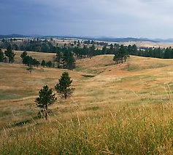
 | Lewiston Pistol Club, Inc Stage: Course Designer: Date:
START POSITION:
GUN READY CONDITION: Loaded gun in holster, hands relaxed at sides. |  | SCORING: Comstock, 00 rounds, 000 points TARGETS: 0 Metric, 0 PP, 0 USP, 0 Plates SCORED HITS: Best 2 per paper, KD steel = 1A START-STOP: Audible - Last shot RULES: USPSA current edition
STAGE PROCEDURE: Upon start signal, engage targets as required to score.
A
LPC
B

Slide 2
 | Lewiston Pistol Club, Inc Stage: Course Designer: Date:
START POSITION:
GUN READY CONDITION: Loaded gun in holster, hands relaxed at sides. |  | SCORING: Comstock, 00 rounds, 000 points TARGETS: 0 Metric, 0 PP, 0 USP, 0 Plates SCORED HITS: Best 2 per paper, KD steel = 1A START-STOP: Audible - Last shot RULES: USPSA current edition
STAGE PROCEDURE: Upon start signal, engage targets as required to score.
A
LPC
B

Slide 3
 | Lewiston Pistol Club, Inc Stage: Course Designer: Date:
START POSITION:
GUN READY CONDITION: Loaded gun in holster, hands relaxed at sides. |  | SCORING: Comstock, 00 rounds, 000 points TARGETS: 0 Metric, 0 PP, 0 USP, 0 Plates SCORED HITS: Best 2 per paper, KD steel = 1A START-STOP: Audible - Last shot RULES: USPSA current edition
STAGE PROCEDURE: Upon start signal, engage targets as required to score.
A
LPC
B
SAVE

Slide 4
Out & Back NS
Out & Back Target
Drop Out Shoot
Drop Out Shoot
Drop Out Penalty
Drop Out Penalty
Flop-Up
Flop-Up
Can-Can Array
USP2
PP2
USP1
Flop-Up
Flop-Up
PP1
T10
Plate Flop-Up
Plate Flop-Up

Slide 5

Free Fire Zone

Slide 6
LPC items
Nickelodeon
Shoot
thru barrel
Drop Out Penalty
B
I
A
N
C
H
I

Slide 8
Ungroup a wall section, select some boards and remove them to create a port, then group the object again.

Slide 9
Walls with see-thru ports
PORT COVER, copy and paste to cover or change size of see-thru ports
Ungroup this wall, then click above, below, left or right of the port and resize the opening, then group the object again.

Slide 10
Walls with see-thru doorways & removable doors
Copy and paste, resize or edit points of this panel to cover or change a see thru doorway.
Doors- copy and paste these to make a door wall.

Slide 11
 | Lewiston Pistol Club, Inc Stage: Course Designer: Date:
START POSITION:
GUN READY CONDITION: Loaded gun in holster, hands relaxed at sides. |  | SCORING: Comstock, 00 rounds, 000 points TARGETS: 0 Metric, 0 PP, 0 USP, 0 Plates SCORED HITS: Best 2 per paper, KD steel = 1A START-STOP: Audible - Last shot RULES: USPSA current edition
STAGE PROCEDURE: Upon start signal, engage targets as required to score.
A
LPC
B
SAVE

Slide 12












 | Lewiston Pistol Club, Inc Stage: Train Robbery Course Designer: J. Simmons Date: 07/13/14
START POSITION: Heels touching the X’s.
GUN READY CONDITION: Loaded gun in holster, hands relaxed at sides. |  | SCORING: Comstock,32rounds, 160 points TARGETS: 14 IPSC,0 PP, 4 USP, 0 Plates SCORED HITS: Best 2 per paper, KD steel = 1A START-STOP: Audible - Last shot RULES: USPSA current edition
STAGE PROCEDURE: You are riding a train through the wilds of the old west hauling gold to the city when you are attacked by train robbers. You were hired to protect the gold. Upon start signal, engage targets as required to score.
LPC
26’
30’
X X

Slide 13


 | Lewiston Pistol Club, Inc Stage: Alien Invasion Course Designer: J.Simmons Date: 6/7/2014
START POSITION: Heels touching X’s.
GUN READY CONDITION: Loaded gun in holster. |  | SCORING: Comstock, 29 rounds, 145 points TARGETS: 12 IPSC, 5 steel SCORED HITS: Best 2 per paper, KD steel = 1A START-STOP: Audible - Last shot RULES: USPSA current edition Procedure Penalty The shield must be held completely in one hand for each shot, or a procedural penalty will be earned for each shot taken without the shield held in a hand.
STAGE PROCEDURE: You have discovered the hiding place of some of the most dangerous aliens to ever invade earth. These bad guys are holding residents hostage. Thankfully, you have invented a body shield that will protect you as long as you are holding it in one of your hands. Now you must find and kill these evil monsters and never shoot unless you have the shield in one of your hands.
LPC
26’
X X
Center
Port

Slide 14








 | Lewiston Pistol Club, Inc Stage: These and Those Course Designer: J.Simmons Date: 7/14/14
START POSITION: Standing in shooting area, facing up range, toes on marks, wrists above shoulders.
GUN READY CONDITION: Loaded gun in holster, wrists above shoulders. |  | SCORING: Comstock, 28 rounds, 140 points TARGETS: 8 IPSC, 4 PP, 0 USP, 8 Plates SCORED HITS: Best 2 per paper, KD steel = 1A START-STOP: Audible - Last shot RULES: USPSA current edition
STAGE PROCEDURE: Upon start signal, engage targets as required to score.
LPC
26’

Slide 15
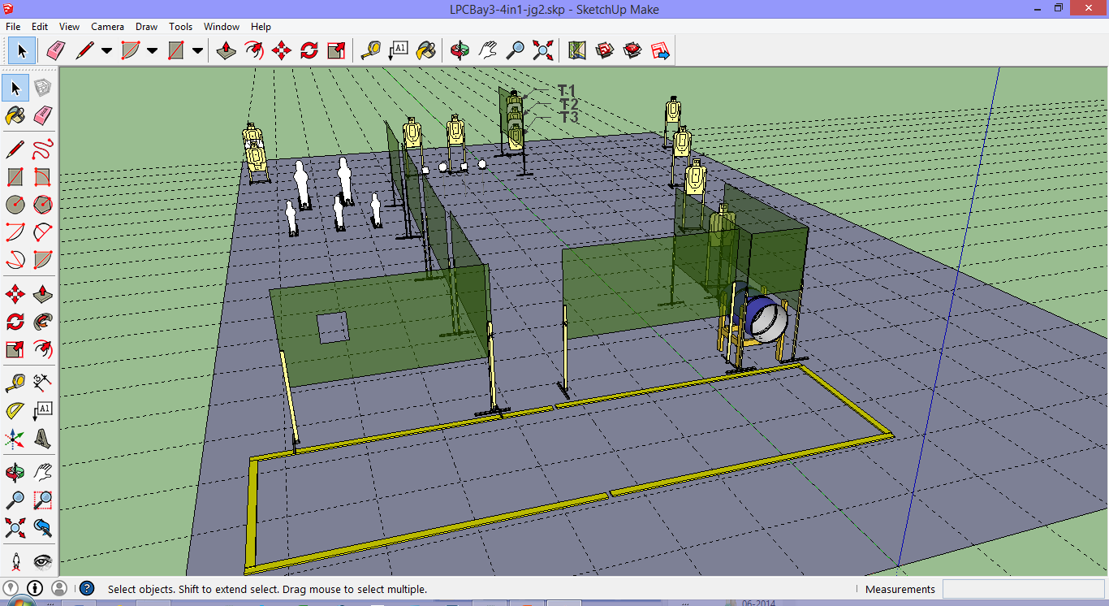
 | Lewiston Pistol Club, Inc Stage: 4 in 1, Action Bay 3 Course Designer: J Grimes Date: 12-7-2014
START POSITION: Facing down range with hands touching X marks. Handgun is loaded and holstered per 8.1.1 and 8.1.2.
STAGE PROCEDURE: Upon start signal engage targets as they become visible from within the fault lines. |  | SCORING: Comstock, 31 rounds, 155 points TARGETS: 11 metric, 2 PP, 3 USP, 4 Plates SCORED HITS: Best 2 per paper, KD steel = 1A START-STOP: Audible - Last shot RULES: USPSA current edition
Setup Notes: Targets T1-T3 should only be addressable from the barrel port. Use snow fence to close the gap above the barrel.
A
LPC
B

Slide 16
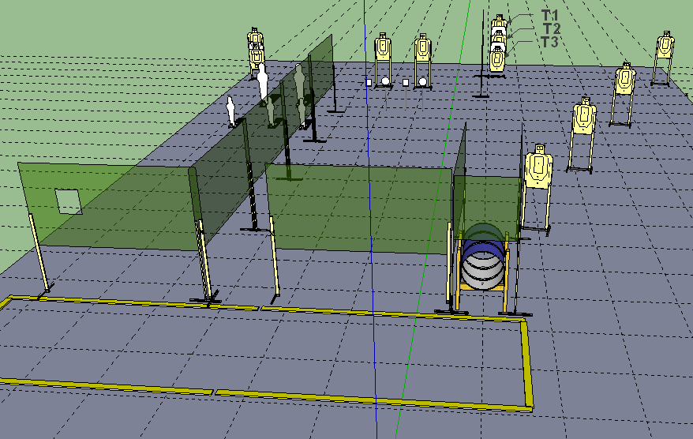
Setup Notes: Targets T1-T3 should only be addressable from the barrel port. Use snow fence to close the gap above the barrel. The shooting area should be 6’ deep.
WSB: 4 in 1 is a 31 round Comstock stage for a total of 155 points. The start position is facing downrange, hands touching Xs, gun loaded and holstered per 8.1.1 and 8.1.2. After the start signal, address the targets as they become available from within the fault lines.

Slide 17
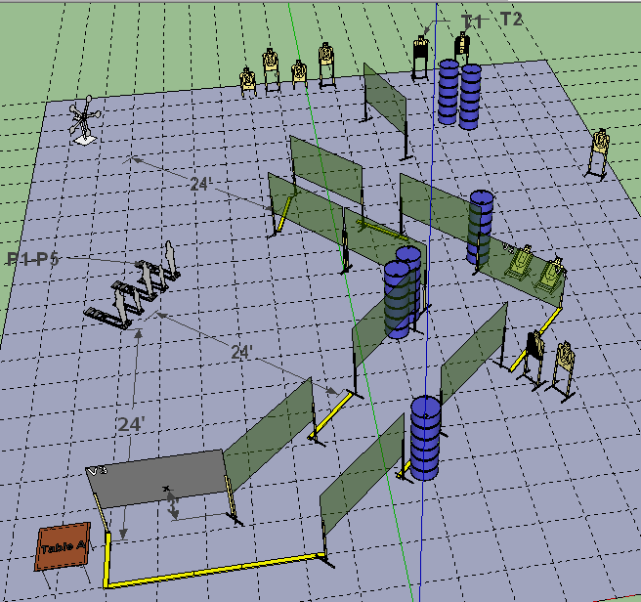
 | Lewiston Pistol Club, Inc Stage: Office Space, Action Bay 1 Course Designer: J Grimes Date: 12-7-2014
START POSITION: Forehead touching X, hands stuffed in coat pockets, complaining about the weather. Unloaded handgun is flat on Table A, pointed downrange. All magazines are carried by the shooter.
Stage Procedure: Upon start signal engage targets as they become visible. |  | SCORING: Comstock, 32 rounds, 160 points TARGETS: 11 metric, 3 PP, 2 USP, 5 Plates SCORED HITS: Best 2 per paper, KD steel = 1A START-STOP: Audible - Last shot RULES: USPSA current edition
Setup Notes: Target T1 should be visible from viewpoint V1; Target T2 should be visible from viewpoint V2. T1 should not be visible from V2; T2 should not be visible from V1. Texas Star and Poppers P1-P5 should be visible on a 45 degree angle from V3. Use a gray wooden wall for the wall marked V3.
A
LPC
B

Slide 18
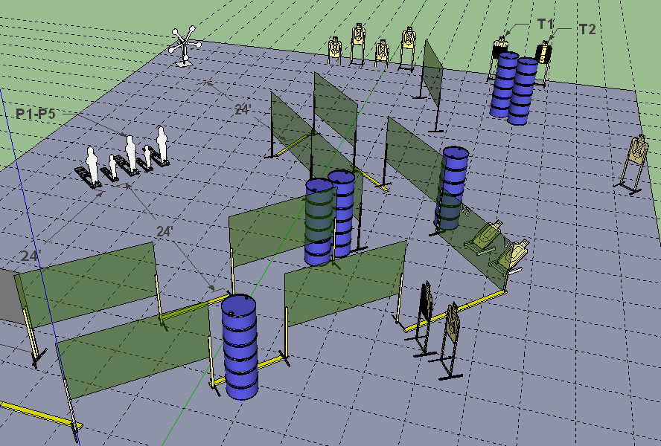
Setup Notes: Target T1 should be visible from viewpoint V1; Target T2 should be visible from viewpoint V2. T1 should not be visible from V2; T2 should not be visible from V1. Texas Star and Poppers P1-P5 should be visible on a 45 degree angle from V3. Use a gray wooden wall for the wall marked V3.
RO Notes: Be alert for shooters to suddenly back up the alley while emitting ohshit noises.
WSB: Office Space is a 32 round Comstock stage for a total of 160 points. The start position is forehead touching X, hands stuffed in coat pockets, complaining about the weather. Unloaded handgun is flat on Table A, pointed downrange. All magazines are carried by the shooter. After the start signal, retrieve the handgun and address the targets as they become available.

Slide 19
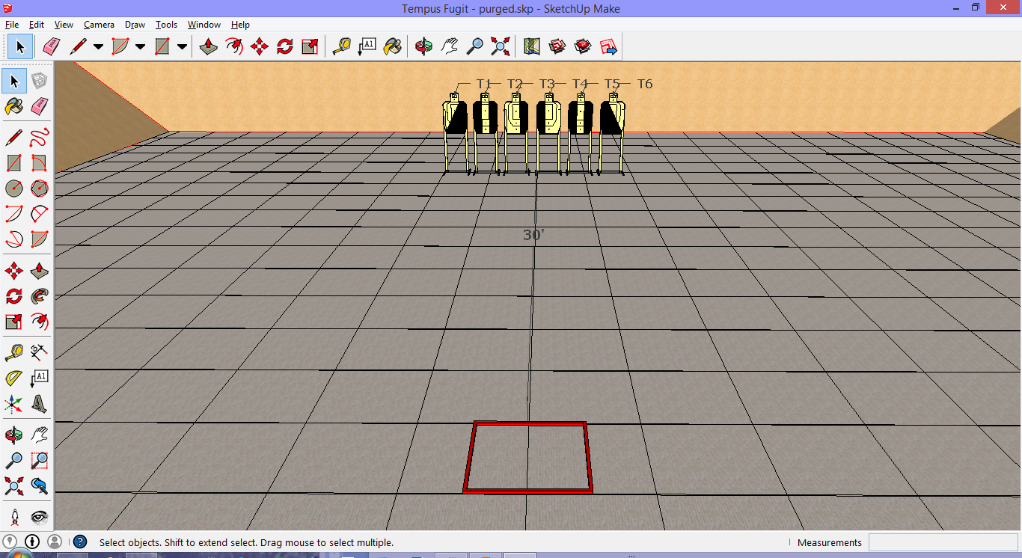
 | Lewiston Pistol Club, Inc Stage: Tempus Fugit, Action Bay 3 Course Designer: J Grimes Date: 12-7-2014
START POSITION: Standing in Box A facing downrange. Handgun is loaded and holstered per 8.1.1 and 8.1.2.
Stage Procedure: Par time for each string is 7 seconds. String 1: Upon the start signal, using weak hand only, engage T1-T6 with one round each from within the fault lines. String 2: Upon the start signal, using strong hand only, engage T1-T6 with one round each from within the fault lines. String 3: Upon start signal, using freestyle, engage T1 -T6 with one round each, perform a mandatory reload, and engage T1 through T6 with one round each from within the fault lines. |  | SCORING: Fixed Time, 24 rounds, 120 pts TARGETS: 6 metric SCORED HITS: Best 2 per paper, KD steel = 1A START-STOP: Audible - Last shot RULES: USPSA current edition
A
LPC
B

Slide 20
Setup Notes: Center targets on shooting box with 6” between target edges.
RO Notes: Consider making 2-3 sets of painted targets depending on the weather and number of squads. Each shot fired 0.30 seconds after the par timer sounds results in a 5 point penalty to the shooter’s overall score. Both hands may be used for reloading and clearing malfunctions.
WSB: “Time Flies” is a three-string, Fixed Time, Standard Exercise course of fire of 24 rounds for a total of 120 points with a seven second par time for each string. This stage is scored Virginia Count. Each shot fired 0.30 seconds after the par timer sounds results in a 5 point penalty to the shooter’s overall score. Both hands may be used for reloading and clearing malfunctions.
String 1: Upon the start signal, using weak hand only, engage T1-T6 with one round each from within the fault lines.
String 2: Upon the start signal, using strong hand only, engage T1-T6 with one round each from within the fault lines.
String 3: Upon start signal, using freestyle, engage T1 -T6 with one round each, perform a mandatory reload, and engage T1 through T6 with one round each from within the fault lines.

Slide 21
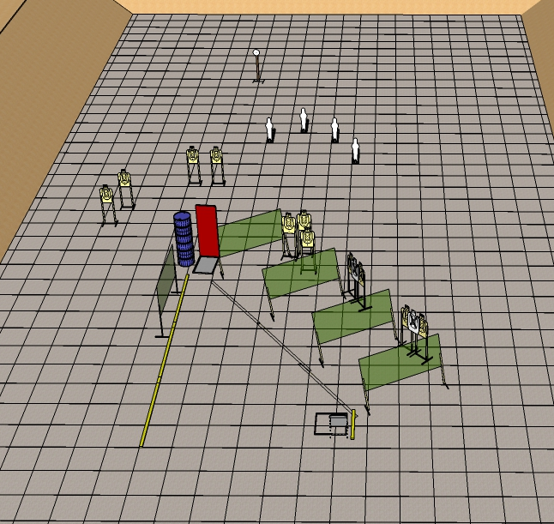
 | Lewiston Pistol Club, Inc Stage: Havana Cancellation Course Designer: Mike Gaffney Date: 4-4-2014
START POSITION: Sitting in chair, fingers laced behind head, eyes closed, feet flat on the ground, mouth open, tongue protruding.
GUN READY CONDITION: Loaded gun in holster. |  | SCORING: Comstock, 27 rounds, 135 points TARGETS: 11 Metric, 2 PP, 2 USP, 1 Plates SCORED HITS: Best 2 per paper, KD steel = 1A START-STOP: Audible - Last shot RULES: USPSA current edition
STAGE PROCEDURE: Upon start signal, engage targets as required to score. Setup note – plate at the rear must be able to fall.
A
LPC
B

Slide 22
 | Lewiston Pistol Club, Inc Stage: Home Invasion Course Designer: Roger Watson, LPC Date: 7/7/2013
START POSITION: Outside the front door, hands in back pockets.
GUN READY CONDITION: Loaded gun in holster. |  | SCORING: Comstock, 24 rounds, 120 points TARGETS: 12 Metric SCORED HITS: Best 2 per paper, KD steel = 1A START-STOP: Audible - Last shot RULES: USPSA current edition
STAGE PROCEDURE: There has been a home invasion robbery. The bad guys are in the home holding the residents hostage. Shooters must go thru the front door to enter the house. All barricades are hard cover.
LPC
B
4’ tall barricade
B
I
A
N
C
H
I
Center
Port
Shoot
thru barrel

Slide 23
 | Lewiston Pistol Club, Inc Stage: Double Fault Course Designer: Roger Watson, LPC Date: 7/7/2013
START POSITION: Hands on X's
GUN READY CONDITION: Loaded gun in holster. |  | SCORING: Comstock, 26 rounds, 130 points TARGETS: 8 Metric, 1 PP, 1 USP, 8 Plates SCORED HITS: Best 2 per paper, KD steel = 1A START-STOP: Audible - Last shot RULES: USPSA current edition
STAGE PROCEDURE: Upon start signal, engage targets from within the two fault zones.
A
LPC
B
8 yards
4 x 8’
X
X
4 x 8’

Slide 24
 | Lewiston Pistol Club, Inc Stage: Carjacking Course Designer: Roger Watson, LPC Date: 7/7/2013
START POSITION: Seated in driver's seat (chair) with firearm loaded and holstered. Dummy in the passenger's seat.
GUN READY CONDITION: Loaded gun in holster, hands at 10 and 2. |  | SCORING: Comstock, 12 rounds, 60 points TARGETS: 6 Metric, 0 PP, 0 USP, 0 Plates SCORED HITS: Best 2 per paper, KD steel = 1A START-STOP: Audible - Last shot RULES: USPSA current edition
STAGE PROCEDURE: Upon start signal, engage targets as required to score. Shooter must remain seated.
A
LPC
B
window ports
20” x 30”
steering
wheel
Width 5’
‘passenger’
In chair

Slide 25
 | Lewiston Pistol Club, Inc Stage: Trifecta Bravo Course Designer: Mike Gaffney Date: 6 January, 2013
START POSITION: Hands relaxed at side in box A
GUN READY CONDITION: Loaded gun in holster, hands relaxed at sides. |  | SCORING: Comstock, 22 rounds, 110 points TARGETS: 4 IPSC, 4 PP, 5 MP, 5 Plates SCORED HITS: Best 2 per paper, KD steel = 1A START-STOP: Audible - Last shot RULES: USPSA current edition
STAGE PROCEDURE: Upon start signal, engage targets as required to score.
LPC
B
30
28
28
28
60
24
26
20
16
16
Fault line
A

Slide 26
 | Lewiston Pistol Club, Inc Stage: Trifecta Alpha Course Designer: Mike Gaffney Date: 6 January, 2013
START POSITION: Hands relaxed at side in box A
GUN READY CONDITION: Loaded gun in holster, hands relaxed at sides. |  | SCORING: Comstock, 23 rounds, 115 points TARGETS: 10 IPSC, 2 PP, 1 MP, 0 Plates SCORED HITS: Best 2 per paper, KD steel = 1A START-STOP: Audible - Last shot RULES: USPSA current edition
STAGE PROCEDURE: Upon start signal, engage targets as required to score.
LPC
B
57
Out & Back NS
54
51
45
21
21
21
18
12
15
12
Fault line
12
12
Fault line
Fault line
A

Slide 27
 | Lewiston Pistol Club, Inc Stage: M Course Designer: Mike Gaffney Date: 6 January, 2013
START POSITION: Hands relaxed at side in box A
GUN READY CONDITION: Loaded gun in holster, hands relaxed at sides. |  | SCORING: Comstock, 24 rounds, 120 points TARGETS: 9 IPSC, 5 PP,1 MP, 0 Plates SCORED HITS: Best 2 per paper, KD steel = 1A START-STOP: Audible - Last shot RULES: USPSA current edition
STAGE PROCEDURE: Upon start signal, engage targets as required to score.
LPC
B
33
36
36
33
33
30
27
15
12
15
12
12
12
Fault line
Fault line
Fault line
A

Slide 28
 | Lewiston Pistol Club, Inc Stage: Echelon Right Course Designer: Mike Gaffney Date: 6 January, 2013
START POSITION: Hands relaxed at side in box A
GUN READY CONDITION: Loaded gun in holster, hands relaxed at sides. |  | SCORING: Comstock, 26 rounds, 130 points TARGETS: 10 IPSC, 5 PP, 0 USP, 1 Plates SCORED HITS: Best 2 per paper, KD steel = 1A START-STOP: Audible - Last shot RULES: USPSA current edition
STAGE PROCEDURE: Upon start signal, engage targets as required to score.
LPC
B
60
Drop Out Shoot
30
60
15
45
30
Fault line
12
30
Fault line
A

Slide 29
 | Lewiston Pistol Club Walker, Texas close-Ranger Course Designer: J Grimes, LPC
START POSITION: Standing in Box A, facing down range, hands on the Xs
GUN READY CONDITION: Gun unloaded lying un-propped on the barrel with magazines carried by shooter. |  | SCORING: Comstock, 32 rounds, 160 points TARGETS: 9 Metric, 14 Steel SCORED HITS: Best 2 per paper, KD steel = 1A START-STOP: Audible - Last shot RULES: USPSA current edition
STAGE PROCEDURE: Upon start signal, acquire pistol and engage targets as required to score.
LPC
8 yards
Fault line
Single
drop
turner
(persistent)
Double
drop
turner
(disappearing)
No shoots cover
lower target
completely in
low position
Box A

Slide 30
 | Lewiston Pistol Club, Inc Stage: The aim is the thing Course Designer: J Grimes, LPC Date: March 5. 2013
START POSITION: Standing in Box A, hands relaxed at sides.
GUN READY CONDITION: Loaded gun in holster, hands relaxed at sides. |  | SCORING: Comstock, 32 rounds, 160 points TARGETS: 16 Metric, 0 PP, 0 USP, 0 Plates SCORED HITS: Best 2 per paper, KD steel = 1A START-STOP: Audible - Last shot RULES: USPSA current edition
STAGE PROCEDURE: Upon start signal, engage targets as required to score.
LPC
B
Fault line
A

Slide 31
 | Lewiston Pistol Club, Inc Stage: Ports Ahoy! Course Designer: J Grimes, LPC Date: 3/6/2013
START POSITION: Standing in Box A, hands relaxed at sides.
GUN READY CONDITION: Loaded gun in holster. |  | SCORING: Comstock, 29 rounds, 145 points TARGETS: 11 Metric, 7 PP, 0 MP, 0 Plates SCORED HITS: Best 2 per paper, KD steel = 1A START-STOP: Audible - Last shot RULES: USPSA current edition
STAGE PROCEDURE: Upon start signal, engage targets as required to score. Target X must be activated prior to engaging.
LPC
B
Array A2
Fault line
Array A3
Port
at 4’
Array A1
Center
Port
B
I
A
N
C
H
I
Shoot
thru barrel
Set up note: Array A2 should only be
visible from Port A2.
A

Slide 32
 | Lewiston Pistol Club, November 7, 2010 God Damnit, Roger! Course Designer: Roger Watson
START POSITION: Standing in Box A, facing down range, hands relaxed at side.
GUN READY CONDITION: Loaded gun in holster. |  | SCORING: Comstock, 27 rounds, 135points TARGETS: 8 Metric, 11 Plates SCORED HITS: Best 2 per paper, KD steel = 1A START-STOP: Audible - Last shot RULES: USPSA current edition
STAGE PROCEDURE: Upon start signal, engage targets as required to score.
LPC
8 yards
8 yards
Fault line
Box A

Slide 33
 | Lewiston Pistol Club, Inc Stage: If it’d been 19/11 Course Designer: John Grimes
START POSITION: Sitting on bucket B1, hands on knees, head in hands, toes touching back of edge of bear trap, regret from eating airport tacos on face, when you think you hear, “We are hijacking this plane!”
GUN READY CONDITION: Loaded gun in holster, hands relaxed at sides. |  | SCORING: Comstock, 30 rounds, 150 points TARGETS: 15 Metric, 0 PP, 0 USP, 0 Plates SCORED HITS: Best 2 per paper, KD steel = 1A START-STOP: Audible - Last shot RULES: USPSA current edition
STAGE PROCEDURE: Upon start signal, engage targets as required to score. T1/2 & T3 must be activated before engaging and are non-disappearing. PT1 & 2 (Pilot Targets) should be positioned so shooter must move down hall to avoid hitting them.
A
LPC
B
PT1
PT2
T2
T3
T1
10’
Trip wire
15’
15’
B1

Slide 34
 | Lewiston Pistol Club, Inc Stage: Down the Hall Course Designer: J Grimes Date: 3/4/2012 – Action Bay 1
START POSITION: Shooter starts with both palms on the Xs.
GUN READY CONDITION: Loaded gun in holster. |  | Corridor: Comstock, 32 rounds, 160 points Runner: Comstock TARGETS: 16 Metric SCORED HITS: Best 2 per paper, KD steel = 1A START-STOP: Audible - Last shot
STAGE PROCEDURE: Upon start signal, open door and engage targets. T1 & T2 must be engaged through low port. T3 – T5 must be engaged through barrel. All walls are hard cover.
A
LPC
B
T5
T4
T3
T2
T1
low
ports
X
X

Slide 35
 | Lewiston Pistol Club, Inc Stage: Back up the Hall Course Designer: J Grimes Date: 3/4/2012 – Action Bay 1
START POSITION: Standing in Box A, facing up range.
GUN READY CONDITION: Loaded gun in holster, hands relaxed at sides. |  | Corridor: Comstock, 32 rounds, 160 points Runner: Comstock TARGETS: 16 Metric SCORED HITS: Best 2 per paper, KD steel = 1A START-STOP: Audible - Last shot
STAGE PROCEDURE: On start signal, turn and engage targets as presented. Shooter must walk backwards up range. T1 & T2 must be engaged through low port. T3 – T5 must be engaged through barrel. All walls are hard cover.
LPC
B
T5
T4
A
T3
T2
T1
low
port

Slide 36
 | Lewiston Pistol Club, Inc Stage: Shee-oot! * no longer legal * Course Designer: J Grimes Date: 3/4/2012 – Action Bay 2
START POSITION: START POSITION: Begin standing in Box A or Box B, facing up range.
GUN READY CONDITION: Loaded gun in holster, hands relaxed at sides. |  | SCORING: Comstock, 16 rounds, 80 points TARGETS: 8 Metric SCORED HITS: Best 2 per paper, KD steel = 1A START-STOP: Audible - Last shot
STAGE PROCEDURE: Upon start signal, turn & engage targets.
A
LPC
B
Fault line
B
25’
A
B

Slide 37
 | Lewiston Pistol Club, November 7, 2010 God Damnit, Roger! Course Designer: Roger Watson
START POSITION: Hands relaxed at side in box A
GUN READY CONDITION: Loaded gun in holster. |  | SCORING: Comstock, 27 rounds, 135points TARGETS: 8 Metric, 11 Plates SCORED HITS: Best 2 per paper, KD steel = 1A START-STOP: Audible - Last shot RULES: USPSA current edition
STAGE PROCEDURE: Upon start signal, engage targets as required to score.
LPC
8 yards
8 yards
Fault line
Fault line
Box A

Slide 38
 | Lewiston Pistol Club Run and Fun (upper bay at BP Range) Course Designer: Roger Watson
START POSITION: Hands relaxed at sides.
GUN READY CONDITION: Loaded gun in holster. |  | SCORING: Comstock, 30 rounds, 150 points TARGETS: 13 Metric, 4 PP SCORED HITS: Best 2 per paper, KD steel = 1A START-STOP: Audible - Last shot RULES: USPSA current edition
STAGE PROCEDURE: Upon start signal, engage targets as required to score.
LPC
8 yards
8 yards
Fault line
Fault line
Shooting box

Slide 39
 | Lewiston Pistol Club November 7, 2010 Shoot up the saloon! Course Designer: The Roger Watson
START POSITION: Hands at side, pistol loaded and holstered, standing behind door.
GUN READY CONDITION: Loaded gun in holster. |  | SCORING: Comstock, 20 rounds, 100 points TARGETS: 10 Metric, 0 PP, 0 USP, 0 Plates SCORED HITS: Best 2 per paper, KD steel = 1A START-STOP: Audible - Last shot RULES: USPSA current edition
STAGE PROCEDURE: Upon start signal, engage targets as required to score. Do not shoot the dance hall girls!
LPC
Saloon mirror
Fault line
5’
5’

Slide 40
 | Lewiston Pistol Club, Inc Stage: Door What? Course Designer: Don Woods Date: 12/5/2010
START POSITION:
GUN READY CONDITION: Loaded gun in holster, hands relaxed at sides. |  | SCORING: Comstock, 00 rounds, 000 points TARGETS: 0 Metric, 0 PP, 0 USP, 0 Plates SCORED HITS: Best 2 per paper, KD steel = 1A START-STOP: Audible - Last shot RULES: USPSA current edition
STAGE PROCEDURE: Upon start signal, engage targets as required to score.
LPC

Slide 41
 | Lewiston Pistol Club, Inc Stage: Double Tap Pairs Course Designer: Don Wood Date: 12/5/2010
START POSITION: Standing in Box A, engage all steel targets. Move to Box B and engage paper targets with 2 rounds each.
GUN READY CONDITION: Loaded gun in holster, hands relaxed at sides. |  | SCORING: Comstock, 12 rounds, 60 points TARGETS: 03 Metric, 3 PP, 3 Plates SCORED HITS: Best 2 per paper, KD steel = 1A START-STOP: Audible - Last shot RULES: USPSA current edition
STAGE PROCEDURE: Upon start signal, engage targets as required to score.
LPC
A
B
3’
15’
30’
B
A

Slide 42
 | Lewiston Pistol Club, Inc Stage: Voodoo Medicine (adapted) Course Designer: Bill Quintana CRO Date: 12/5/2010
START POSITION: Standing with palms flat against both Xs on wall.
GUN READY CONDITION: Loaded gun in holster. |  | SCORING: Comstock, 18 rounds, 90 points TARGETS: 9 Metric SCORED HITS: Best 2 per paper, KD steel = 1A START-STOP: Audible - Last shot RULES: USPSA current edition
STAGE PROCEDURE: Upon start signal, engage targets as visible
A
LPC
B
X
X

Slide 43
 | Lewiston Pistol Club, Inc Stage: Drug Smuggling Tunnel Course Designer: Roger Watson Date: 8-7-2011
START POSITION: Standing on second step of step ladder, facing up range.
GUN READY CONDITION: Loaded gun in holster, hands in surrender position. |  | SCORING: Comstock, 14 rounds, 70 points TARGETS: 7 Metric SCORED HITS: Best 2 per paper, START-STOP: Audible - Last shot RULES: USPSA current edition
STAGE PROCEDURE: Upon start signal, engage targets as required to score. 3 seconds added to score assessed if shooter does not use step ladder.
A
LPC
B
Snow fencing
6’

Slide 44
 | Lewiston Pistol Club, Inc Stage: Shoot Both Sides Course Designer: Roger Watson Date: 8-7-2011
START POSITION: Standing in Start box, facing down range
GUN READY CONDITION: Loaded gun in holster, hands relaxed at sides. |  | SCORING: Comstock, 23 rounds, 115 points TARGETS: 8 Metric, 7 Steel SCORED HITS: Best 2 per paper, Steel KD = 1A START-STOP: Audible - Last shot RULES: USPSA current edition
STAGE PROCEDURE: Upon start signal, engage targets as available. Snow fencing is hard cover.
A
LPC
B
24’
24’
Fault line
Snow fencing
Fault line
6’
A

Slide 45
 | Lewiston Pistol Club, Inc Stage: Shoot from behind the Barricade Course Designer: Roger Watson Date: 8-7-2011
START POSITION: Standing in Bianchi Barricade shooting box.
GUN READY CONDITION: Loaded gun in holster, hands relaxed at sides. |  | SCORING: Comstock, 16 rounds, 80 points TARGETS: 6 Metric, 4 PP SCORED HITS: Best 2 per paper, KD steel = 1A START-STOP: Audible - Last shot RULES: USPSA current edition
STAGE PROCEDURE: Upon start signal, engage targets as required to score. Shooter must stay in shooting box.
A
LPC
B
Wooden partitions
B
I
A
N
C
H
I

Slide 46
 | Lewiston Pistol Club, Inc Stage: No Shoot, Sherlock! Course Designer: J Grimes Date: 12/4/2011
START POSITION: Standing in box A, facing up range
GUN READY CONDITION: Loaded gun in holster, hands relaxed at sides. |  | SCORING: Comstock, 19 rounds, 125 points TARGETS: 5 Metric, 2 PP, 7 Plates SCORED HITS: Best 2 per paper, KD steel = 1A START-STOP: Audible - Last shot RULES: USPSA current edition
STAGE PROCEDURE: Upon start signal, turn and engage targets as required to score. Targets T1 – T3 and P1 & P2 must be engaged from between the Bianchi barriers.
A
LPC
B
A

Slide 47
 | Lewiston Pistol Club, Inc Stage: Judge Roy Bean (J Kimball, adapted) Course Designer: J Grimes Date: 12/4/2011
START POSITION: Seated at the bench with gavel in strong hand. Loaded pistol lying on mat in front center of bench. Pistol may not be propped up in any way.
GUN READY CONDITION: Seated at the bench with gavel in strong hand. Loaded pistol lying on mat in front center of bench. Pistol may not be propped up in any way. |  | SCORING: Comstock, 25 rounds, 125 points TARGETS: 8 Metric, 2 PP, 7 Plates SCORED HITS: Best 2 per paper, KD steel = 1A START-STOP: Audible - Last shot RULES: USPSA current edition
STAGE PROCEDURE: On the command “Are you ready?” the judge begins banging the gavel on block and continues to the beep. Targets T1, T2, PP1, USP1 must be engaged from between the two NS in front of the bench only. Targets T3, T4, T5, T6, USP2, USP3 may be engaged any where. Targets T7, T8, P1 P2 must be engaged from the “doorway” only.
A
LPC
B
B
I
A
N
C
H
I
B
I
A
N
C
H
I

Slide 48
 | Lewiston Pistol Club, Inc Stage: Barrels of Fun Course Designer: Roger Watson Date: 1/8/2012
START POSITION:
GUN READY CONDITION: Loaded gun in holster, hands relaxed at sides. |  | SCORING: Comstock, 14 rounds, 70points TARGETS: 7 Metric, 0 PP, 0 USP, 0 Plates SCORED HITS: Best 2 per paper, KD steel = 1A START-STOP: Audible - Last shot RULES: USPSA current edition
STAGE PROCEDURE: Upon start signal, engage targets as required to score.
LPC
B
A

Slide 49
 | Lewiston Pistol Club, Inc Stage: Hollywood & Vine Course Designer: Roger Watson Date: 1/8/2012
START POSITION:
GUN READY CONDITION: Loaded gun in holster, hands relaxed at sides. |  | SCORING: Comstock, 12 rounds, 60 points TARGETS: 6 Metric, 0 PP, 0 USP, 0 Plates SCORED HITS: Best 2 per paper, KD steel = 1A START-STOP: Audible - Last shot RULES: USPSA current edition
STAGE PROCEDURE: Upon start signal, engage targets as required to score.
A
LPC
B
Vine
Hollywood Blvd
Truck
Pink tape = curbs
A

Slide 50
 | Lewiston Pistol Club, Inc Stage: Double Barricade Course Designer: Roger Watson Date: 1/8/2012
START POSITION:
GUN READY CONDITION: Loaded gun in holster, hands relaxed at sides. |  | SCORING: Comstock, 22 rounds, 70 points TARGETS: 5 Metric, 3 PP, 2 USP, 7 Plates SCORED HITS: Best 2 per paper, KD steel = 1A START-STOP: Audible - Last shot RULES: USPSA current edition
STAGE PROCEDURE: Upon start signal, engage targets as required to score.
A
LPC
B
← 24’ →
← 24’ →
← 24’ →
Fault line
Fault line
B
I
A
N
C
H
I
B
I
A
N
C
H
I

Slide 51
 | Lewiston Pistol Club, Inc Stage: No Shoot! Quit moving! Course Designer: J Grimes Date: 2/26/2012 – Upper Bay
START POSITION: START POSITION: Shooter’s choice on start position & timekeeping.
GUN READY CONDITION: Loaded gun in holster, hands relaxed at sides. |  | SCORING: Comstock, 38 rounds, 190 points TARGETS: 16 Metric, 2 PP, 2 USP, 2 Plate SCORED HITS: Best 2 per paper, KD steel = 1A START-STOP: Audible - Last shot
STAGE PROCEDURE: Upon start signal, engage targets.
A
LPC
B
Fault line
B
B
Nickelodeon
Beginning in Box A
Drop Out Shoot
24’
Fault line

Slide 52

 | Lewiston Pistol Club, Inc Stage: Deep in the heart of Texas! Course Designer: J Grimes Date: 2/26/2012 - Middle Bay
START POSITION: Shooter’s choice on start position & timekeeping.
GUN READY CONDITION: Loaded gun in holster, hands relaxed at sides. |  | SCORING: Comstock, 36 rounds, 180 points TARGETS: 10 Bowling Pins, 31 Plates SCORED HITS: Best 2 per paper, KD steel = 1A START-STOP: Audible - Last shot
STAGE PROCEDURE: Upon start signal, engage targets.
A
LPC
B
24’
Fault line

Slide 53
 | Lewiston Pistol Club, Inc Stage: Tueller Drill / Action Corridor Course Designer: J Grimes Date: 2/26/2012 – Lower Bay
START POSITION: Shooter’s choice on start position & timekeeping.
GUN READY CONDITION: Loaded gun in holster, hands relaxed at sides. |  | Corridor: Comstock, 30 rounds, 150 points Runner: Comstock, Score all hits TARGETS: Corridor 15 Metric/Runner - IDPA SCORED HITS: Best 2 per paper, KD steel = 1A START-STOP: Audible - Last shot
STAGE PROCEDURE: Upon start signal, engage targets. Corridor: Shooter may start at either end of corridor. Runner: Begin each shooter with new target (T1) if desired. Runner PM shooters must stay in Box A. Use IDPA targets.
A
LPC
B
T1
Fault Line
Runner AM
T1
Hi &
low
ports
Corridor
A
Runner PM

Slide 54
 | Lewiston Pistol Club, Inc Stage: Rock, Paper, Steel Course Designer: J Grimes Date: 3/4/2012 - Action Bay 2
START POSITION: Shooter’s choice on start position & timekeeping.
GUN READY CONDITION: Piston unloaded and in holster, hands relaxed at sides. |  | SCORING: Comstock, 18 rounds, 80 points TARGETS: 5 Metric, 8 Plates SCORED HITS: Best 2 per paper, KD steel = 1A START-STOP: Audible - Last shot
STAGE PROCEDURE: Standing in Box A, holding rock in each hand. Upon start signal, load handgun and engage targets.
LPC
B
Not used in any action match
24’
Fault line
A

